Slide 1
Machine Guarding

Slide 2
Disclaimer
This material was produced under grant number
SH-05029-SH8 from the Occupational Safety and Health Administration, U.S. Department of Labor. It does not necessarily reflect the views or policies of the U.S. Department of Labor, nor does mention of trade names, commercial products, or organizations imply endorsement by the U.S. Government..

Slide 3
OSHA’s Mission
With the Occupational Safety and Health Act of 1970, Congress created the Occupational Safety and Health Administration (OSHA) to assure safe and healthful working conditions for working men and women by setting and enforcing standards, providing training, outreach, education and assistance. Additional information can be found on the OSHA Website at https://www.osha.gov/

Slide 4
OSHA’s Whistleblower Protection Program
This program enforces the whistleblower provisions of more than 20 whistleblower statutes protecting employees who report various workplace violations. In general, the whistleblower anti-retaliation provision provide that employers may not discharge or otherwise retaliate against an employee because the employee has filed a complaint or exercised any rights provided to employees. More information can be found on the Whistleblowers Website at https://www.whistleblowers.gov/

Slide 5
Agenda
Accidents Related to Unguarded Equipment
Elements of a Machine Guarding Program
OSHA Regulations for Machine Guarding
Types of Guards and Devices
Guarding by Location and Distance
Robots in the Workplace
Hazards of Unguarded Machines
Requirements for Guarding
Workshop discussion for practical application of various type of guards and devices

Slide 6
OSHA Data – Accident Search Results (Keyword: machine guarding)
Event Date: 01/26/2018 – Employee is killed by tire recycling shredder
Event Date: 01/25/2018 – Employee dies after being caught in auger
Event Date: 11/17/2017 – Employee amputates three fingertips clearing jammed vacuum sealer
Event Date: 11/16/2017 – Employee catches gloved hand on a rotating shaft and suffered a compound fracture to his left wrist

Slide 7
OSHA Data – Accident Search Results (Keyword: machine guarding) (continued)
Event Date: 11/07/2017 – Employee fractures skull while operating a CNC machine
Event Date: 11/06/2017 – Employee’s right ring finger is amputated by hydraulic press
Event Date: 11/03/2017 – Employee is troubleshooting equipment and amputated the tip of middle finger and broke his ring finger
Event Date: Employee catches finger between chain and sprocket and amputates his right hand index finger

Slide 8

Statistics
Workers who operate and maintain machinery suffer approximately 18,000 amputations, lacerations, crushing injuries, abrasions, and over 800 deaths per year in the United States
(Sources: OSHA website)

Slide 9
Statistics – National Safety Council-Injury Facts - 2016
The top three leading causes of work-related injuries:
#1 Overexertion, bodily reaction
#2 Contact with objects/equipment
#3 Falls, slips, trips

Slide 10
Statistics – National Safety Council-Injury Facts – 2016 (continued)
Contact with objects/equipment
Injury rate: 23.9 per 10,000 full-time workers
Age group most at risk 16 to 24
Industry most at risk: agriculture, construction and extraction, and transportation and warehousing
Typical days lost: 5
Most frequent type of injury: cuts, lacerations, punctures

Slide 11
Common Machine-related Injuries
Death
Crushing wounds
Cutting and tearing
Puncture wounds
Shearing wounds
Spraining and straining
PTSD*

Slide 12
PTSD – Workers don’t return from injury
Did you know that many workers who sustain both minor and major injuries, including compensable injuries, within weeks or months suffer from episodes of depression?
A study, “Incidence of Depression After Occupational Injury,” conducted by the U.S. Centers for Disease Control and Prevention (CDC) and drawing on nearly 367,900 injured and non-injured workers from a 2005 database, found that the odds of injured workers being treated for depression were 45% higher than those of non-injured workers.

Slide 13
Machines are essential
How do we prevent injuries, amputations, and even death when working with machinery?

Slide 14
Machine Guarding Safety Program
Compliance with:
29 CFR 1910 Subpart O (General Industry)
29 CFR 1926 Subpart I (Construction Industry)
29 CFR 1928 Subpart D (Agriculture Industry)
Lockout/Tagout
Safe Work Practices
Warnings
Inspections
Enforcement
Training

Slide 15
1910.212 – General requirements for all machines (horizontal standard)
1910.212(a)(1) Types of guarding. One or more methods of machine guarding shall be provided to protect the operator and other employees in the machine area from hazards such as those created by point of operation, ingoing nip points, rotating parts, flying chips and sparks. Examples of guarding methods are-barrier guards, two-hand tripping devices, electronic safety devices, etc.
19210.212(a)(2) General requirements for machine guards. Guards shall be affixed to the machine where possible and secured elsewhere if for any reason attachment to the machine is not possible. The guard shall be such that it does not offer an accident hazard in itself
Notes:
There are two type of standards: Horizontal and Vertical Standard. Horizontal standards are standards that apply across the many different types of industries. Vertical standards are standards that apply to specific industries, such as: wood working, hydraulic presses, etc.. In General Industry 1910, standard 1910.212(a)(1) and 1910.212(a)(2) are board in nature and encompasses all industries that fall under the 1910 standard. In summary if any part of your body can come into contact with a moving part and/or you can be exposed to flying debris, there must be a guard to protect the workers.

Slide 16
Check Your Knowledge
Machinery, such as grinders or buffers when secured to a work bench, the work bench must be securely anchored to prevent walking or moving?
(reference standard interpretations/Interlock requirements for access door(s) of trash compactor)

Slide 17
1926.300 General requirements
1926.300(b)(1) When power operated tools are designed to accommodate guards, they shall be equipped with such guards when in use.
1926.300(b)(2) Belts, gears, shafts, pulleys, sprockets, spindles, drums, fly wheels, chains, or other reciprocating, rotating or moving parts of equipment shall be guarded if such parts are exposed to contact by employees or otherwise create a hazard. Guarding shall meet the requirements as set forth in American National Standards Institute, B15.1-1953 (R1958), Safety Code for Mechanical Power-Transmission Apparatus.

Slide 18
1928.57 – Guarding of farm field equipment, farmstead equipment, and cotton gins.
1928.57(a)(1) Purpose. The purpose of this section is to provide for the protection from the hazards associated with moving machinery parts of farm field equipment, farmstead equipment, and cotton gins used in any agricultural operations.
1928.57(a)(6)(i) Keep all guards in place when the machine is in operation;
1928.57(a)(7) Methods of guarding….
1928.57(a)(8) Strength and design of guards

Slide 19
1928.57 – Guarding of farm field equipment, farmstead equipment, and cotton gins. (continued)
1928.57(b) Farm field equipment
1928.57(b)(2) Other power transmission components
1928.57(c) Farmstead equipment
1928.57(d) Cotton gin equipment

Slide 20
Check Your Knowledge
Per the OSHA Agriculture regulations, employees operating or servicing all covered equipment all required to receive operating instructions at the time of initial assignment?
(reference 1928.57(a)(6))

Slide 21
Check Your Knowledge
Per the OSHA Agriculture regulations, unless otherwise specified, each guard and its support shall be capable of withstanding the force that a (XXX) pound individual, leaning against the guard, would exert upon the guard?
(reference 1928.57(a)(8)(ii))

Slide 22
Check Your Knowledge
All tractors shall be equipped with an agricultural tractor master shield on the rear power take-off with no exceptions?
(reference 1928.57(b)(1)(i))

Slide 23
Types of Guards
Fixed
Interlocked
Adjustable
Self-adjusting

Slide 24
Fixed
What is the purpose?
Provides a barrier
Advantages
Suitable for many applications
In-house fabrication
Provides maximum protection
Usually requires minimum maintenance
Suitable for high production, repetitive operations

Slide 25
Fixed (continued 1)
What is the purpose?
Provides a barrier
Limitations
Interferes with visibility
Limited to specific operations
Machine adjustments and repair often requires its removal

Slide 26
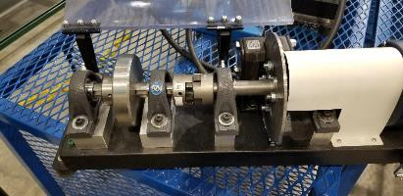
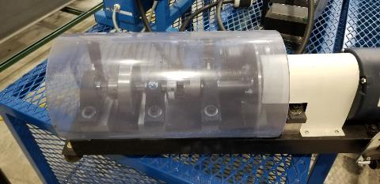
Fixed (continued 2)
What is the purpose?
Provides a barrier

Slide 27
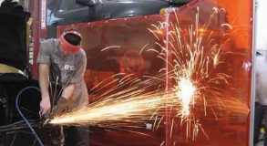
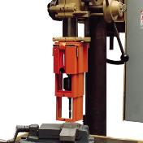
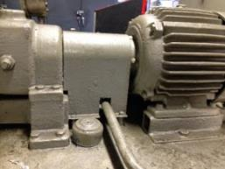
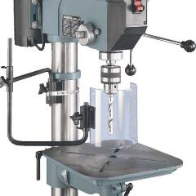
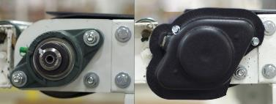
Examples of fixed guards

Slide 28
Interlocked
What is the purpose?
Shuts off or disengages power and prevents starting of machine when guard is open
Advantages
Can provide maximum protection
Allows access to machine for making minor adjustments or removing jams without removal of fixed guards

Slide 29
Interlocked (continued 1)
What is the purpose?
Shuts off or disengages power and prevents starting of machine when guard is open
Limitations
Requires careful adjustment and maintenance

Slide 30
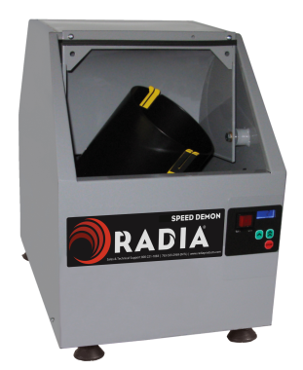
Interlocked (continued 2)
What is the purpose?
Shuts off or disengages power and prevents starting of machine when guard is open

Slide 31
Check Your Knowledge
Is an interlock required on the side door of a trash compactor, if the side door is located 55 inches from ground level, and the door is closed and lathed while the compactor is cycling
(reference standard interpretations/Guarding machines on moveable benches and pedestals)

Slide 32
Adjustable
What is the purpose?
Provides a barrier that may be adjusted to facilitate a variety of production operations
Advantages
Can construct to suit many specific operations
Adjustable to allow for varying sizes of material

Slide 33
Adjustable (continued 1)
What is the purpose?
Provides a barrier that may be adjusted to facilitate a variety of production operations
Limitations
Hands may enter danger area
May require frequent maintenance and adjustment
The guard may be tampered with by the operator

Slide 34
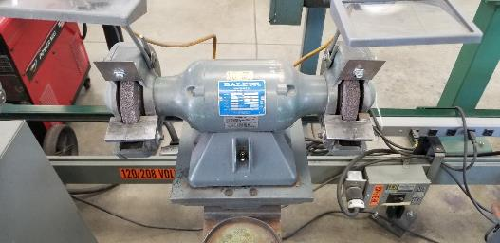
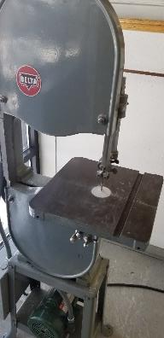
Adjustable (continued 2)
What is the purpose?
Provides a barrier that may be adjusted to facilitate a variety of production operations

Slide 35
Check Your Knowledge
Cutting saw blade or abrasive wheels: Is D’AX wheels considered to be cutting or abrasive wheels in regards to OSHA guarding requirements?
(reference standard interpretations/D’AX wheels are to be guarded as cutting saws)

Slide 36
Self-adjusting
What is the purpose?
Provides barrier that moves according to size of material entering the danger zone
Advantages
Off-the-shelf guards often commercially available

Slide 37
Self-adjusting (continued 1)
What is the purpose?
Provides barrier that moves according to size of material entering the danger zone
Limitations
Does not always provide maximum protection
May interfere with visibility
May require frequent maintenance and adjustment

Slide 38
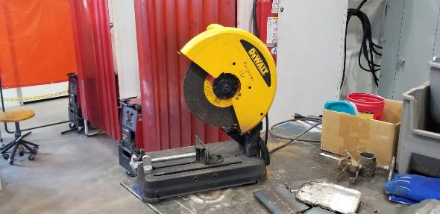
Self-adjusting (continued 2)
What is the purpose?
Provides barrier that moves according to size of material entering the danger zone

Slide 39
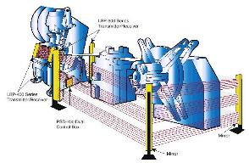
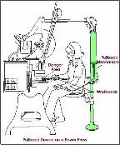
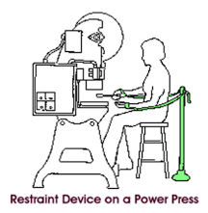
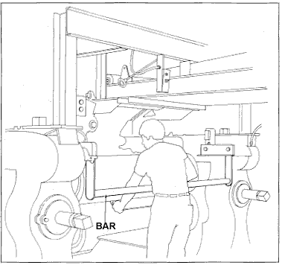
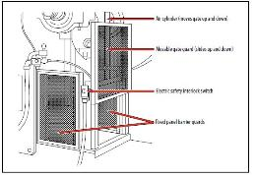
Types of Devices
Presence sensing devices
Restraints
Pullback devices
Safety trip controls
Gates

Slide 40
Presence Sensing Devices (continued 1)
What is the purpose?
Disengage the machine when something is detected in the hazard zone
Types
Photoelectric
Radiofrequency
Electromagnetic

Slide 41
Presence Sensing Devices (continued 2)
What is the purpose?
Disengage the machine when something is detected in the hazard zone
Advantages
All three types can allow free movement for operator
Simplicity of use
Photo electrics requires no adjustment
Limitations
Failures of input/output devices resulting in no detection when something is in the danger zone

Slide 42
Presence Sensing Devices (continued 3)
What is the purpose?
Disengage the machine when something is detected in the hazard zone
Limitations
Does not protect against mechanical failure
Limited to equipment that can be stopped
Sensitivity of antennae may be an issue
Contact bar or probe must be properly adjusted for each application(electro-mechanical)

Slide 43
Check Your Knowledge
Does OSHA have any prohibition on the use of Presense Sensing Device Initiation (PSDI) light curtains in regard to: Mechanical Power Presses, and Hydraulic Welding Presses?
(reference standard interpretations/The use of Presense Sensing Device Initiation light curtains in regard to Mechanical Power Presses, Hydraulic Power Presses and Hydraulic Welding Presses)

Slide 44
Restraint
What is the purpose?
Prevents the operator from reaching into the danger area
Advantages
Little risk of mechanical failure

Slide 45
Restraint (continued)
What is the purpose?
Prevents the operator from reaching into the danger area
Limitations
Limits movements of operator
Requires close supervision of operator’s use of equipment
Requires frequent inspection, maintenance and adjustments

Slide 46
Check Your Knowledge
Does OSHA have a regulation for machine guarding specific to the bowling pin setting machinery?
(reference standard interpretations/OSHA ARCHIVE regarding the subject of guarding machinery in bowling centers)

Slide 47
Pullback
What is the purpose?
As the machine cycle, the operator’s hands are pulled out of the danger zone
Advantages
Eliminates the needs for guards at the danger zone

Slide 48
Pullback (continued)
What is the purpose?
As the machine cycle, the operator’s hands are pulled out of the danger zone
Limitations
Limits movements of operator

Slide 49
Safety trip controls
What is the purpose?
Stops machine when controls tripped
Types
Pressure sensitive body bar
Safety triprod
Two-hand control
Two-hand trip

Slide 50
Safety trip controls (continued 1)
What is the purpose?
Stops machine when controls tripped
Advantages
Simplicity in use
Concurrent use of both hands on separated controls prevent hands from being in danger zone

Slide 51
Check Your Knowledge
Does machine safeguarding requirements apply to refuse balers, compactors and garbage trucks?
(reference standard interpretations/Machine safeguarding requirements apply to refuse industry balers, compactors, and garbage trucks)

Slide 52
Safety trip controls (continued 2)
What is the purpose?
Stops machine when controls tripped
Limitations
Only protects the operator
May require a machine brake
Operator may block one control open

Slide 53
Gates
What is the purpose?
Provided a barrier between danger area and operator or other personnel
Advantages
Can prevent reaching into or walking into the danger zone

Slide 54
Gates (continued)
What is the purpose?
Provided a barrier between danger area and operator or other personnel
Limitations
May require frequent inspection and regular maintenance
May interfere with the operator’s ability to see the work

Slide 55
Guarding by Location and Distance
Location
Position machines so that the dangerous moving parts of a machine are not accessible, or do not present a hazard to the worker during the normal operation of the machine
Minimum distance required from floor to danger zone is 7 feet.
Distance
D = 63 in/s x Ts
D is inches from the point of operation
63 in/s is an assumed hand speed
Ts is the stopping time of the machine in seconds

Slide 56
Check Your Knowledge
Are barrier chains or fencing surrounding the working envelope and employer training and work procedures which prohibit employee access into the work area be considered adequate machine guarding?
(reference standard interpretations/machine guarding and exposure to hazards from robotic laundry shuttles)

Slide 57
Types of Machine Motion
1 Rotating
List examples of rotating motion at your place of employment
Identify hazards resulting for rotating motion
Point of operation, In-running nib points, chips, sparks
Are the examples listed; guarded or unguarded?
If not Why?
Share examples of how rotating motion are guarded at your place of employment
Discussion of Requirements for machine guards

Slide 58
Discussion on Requirements for Machine Guarding (rotating)
Does the current guarding method prevent contact?
Does the guard openings width meet the requirement for the distance a guard must be from a danger line?
Is the machine guard secure?
Does the machine guard create no new Hazards?

Slide 59
Discussion on Requirements for Machine Guarding (rotating continued 1)
Does the guard protect from falling objects?
Does the guard create no interference?
Does the guard allow for safe lubrication?
Does the guarding method allow for work to be done?

Slide 60
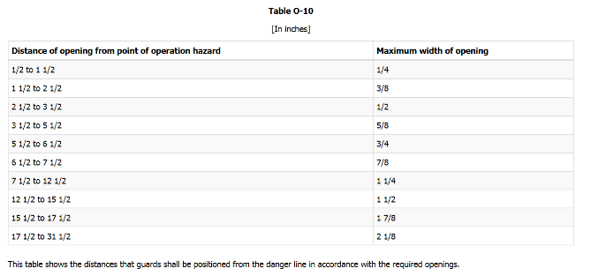
Table O-10
In the 2010 release of ANSI 11.19 there were two fundamental changes:
1: ANSI B11.19 (2010) now applies o ALL machines and equipment.
2: There is no longer any difference between the guarding standards for
- Point of Operation
- Mechanical Transmission Apparatus

Slide 61
Types of Machine Motion (tranverse)
2 Transverse Motions
List examples of transverse motion at your place of employment
Identify hazards resulting for tranverse motion
Are the examples listed; guarded or unguarded?
If not Why?
Share examples of how transverse motion are guarded at your place of employment
Share concerns/issues with current guarding methods

Slide 62
Discussion on Requirements for Machine Guarding (tranverse)
Does the current guarding method prevent contact?
Does the guard openings width meet the requirement for the distance a guard must be from a danger line?
Is the machine guard secure?
Does the machine guard create no new Hazards?
Does the guard protect from falling objects?
Does the guard create no interference?
Does the guard allow for safe lubrication?

Slide 63
Types of Machine Motion (cutting)
3 Cutting Action
List examples of cutting action at your place of employment
Identify hazards resulting for cutting action
Are the examples listed; guarded or unguarded?
If not Why?
Share examples of how cutting actions are guarded at your place of employment
Share concerns/issues with current guarding methods

Slide 64
Discussion on Requirements for Machine Guarding (cutting)
Does the current guarding method prevent contact?
Does the guard openings width meet the requirement for the distance a guard must be from a danger line?
Is the machine guard secure?
Does the machine guard create no new Hazards?
Does the guard protect from falling objects?
Does the guard create no interference?
Does the guard allow for safe lubrication?

Slide 65
Types of Machine Motion (sheet metal)
4 Punching, Shearing, and Bending
List examples of punching, shearing and bending at your place of employment
Identify hazards resulting for punching, shearing and bending
Are the examples listed; guarded or unguarded?
If not Why?
Share examples of how cutting actions are guarded at your place of employment
Share concerns/issues with current guarding methods

Slide 66
Discussion on Requirements for Machine Guarding (sheet metal)
Does the current guarding method prevent contact?
Does the guard openings width meet the requirement for the distance a guard must be from a danger line?
Is the machine guard secure?
Does the machine guard create no new Hazards?
Does the guard protect from falling objects?
Does the guard create no interference?
Does the guard allow for safe lubrication?

Slide 67
Robots in the Workplace
What are industrial robots?
Programmable multifunctional mechanical devices
Designed to move:
Material
Parts
Tools
Specialized devices
An industrial robot system
Includes an industrial robot
devices and/or sensors
Sequencing or monitoring communication devices

Slide 68
Robots in the Workplace (continue)
Why robots?
Used to perform work that is unsafe, hazardous for humans
Highly repetitive and unpleasant tasks
Features of robots
Small to large lifting capacity
High speed
High torque
Six-axis articulation
High payload positioning accuracy

Slide 69
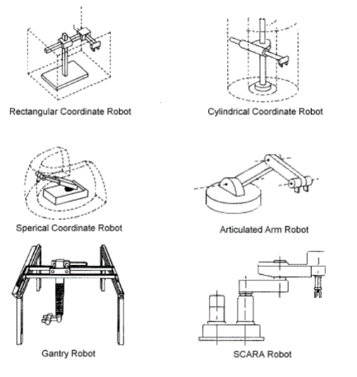
Types and Classification of Robots
Source: OSHA web site

Slide 70
Accidents related to Robots
Studies in Sweden and Japan indicates that many robot accidents do not occur under normal operating conditions but, instead during:
Programming
Program refinement
Maintenance and repair
Testing
Setup and adjustment
All these operations may require personnel to be temporarily within the robot’s working envelope

Slide 71
Typical accidents related to robots
A robot’s arm functioned erratically during programming sequence and struck operator
A materials handling robot operator entered a robot’s work envelope during operations and was pinned between the back end of the robot and safety pole
A fellow employee accidentally tripped the power switch while a maintenance worker was servicing an assembly door. The robot’s arm struck the maintenance worker’s hand

Slide 72
Sources of hazards
Moving mechanical components causing:
Trapping
Crushing
Death
Stored energy
electrical,
Hydraulic
Pneumatic
Gravity
NOTE: unexpected release of stored energy can result in sudden drop of payload, axis arms, etc.

Slide 73
Sources of hazards (continued1)
Hazardous atmospheres, explosive/combustible materials, high or low temperatures
The use of industrial robots to eliminate safety concerns to employees, does not eliminate the safety concerns for those doing maintenance or programming of the robots
Inadvertent operation caused by equipment failure
Actions by personnel, either unintended or deliberate

Slide 74
Eliminating the hazards
Barrier guards, fixed and interlocked
Safety light curtains/screens
Area scanning safeguarding devices
Radio frequency/capacitance safeguarding devices
Safety mat systems
Single and multiple beam safety systems
Two hand control systems

Slide 75

Questions

